Slide 1
Fingerprint Minutiae Matching Using Graph Neural Network with Geometric Invariant Features
Yi Zheng
February 27, 2025

Slide 2
Table of contents
Problem Statement
Existing Solutions & Limitations
Proposed Solution
System Architecture
Preliminary Results
01
02
03
04
05

Slide 3
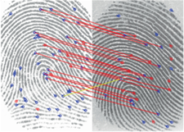
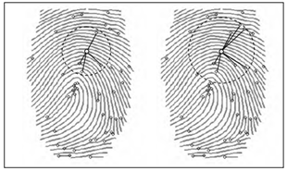
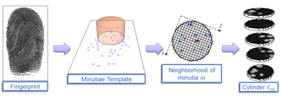
Problem Statement
Minutiae Matching (Traditional)
Use handcrafted representations with local descriptors
Indexing (global matching): MCC
Deep Neural Networks (DNNs)
Maltoni, D., Maio, D., Jain, A.K., Feng, J.(2022). Fingerprint Matching. In: Handbook of Fingerprint Recognition. Springer, Cham
Extract fingerprint features directly from images
Learn trainable global and local image features
Graph Neural Networks (GNNs)
Extract fingerprint features from minutiae
Learn trainable global and local graph features
Biometric System Laboratory (unibo.it)
Minutia Cylinder Code (MCC)

Slide 4
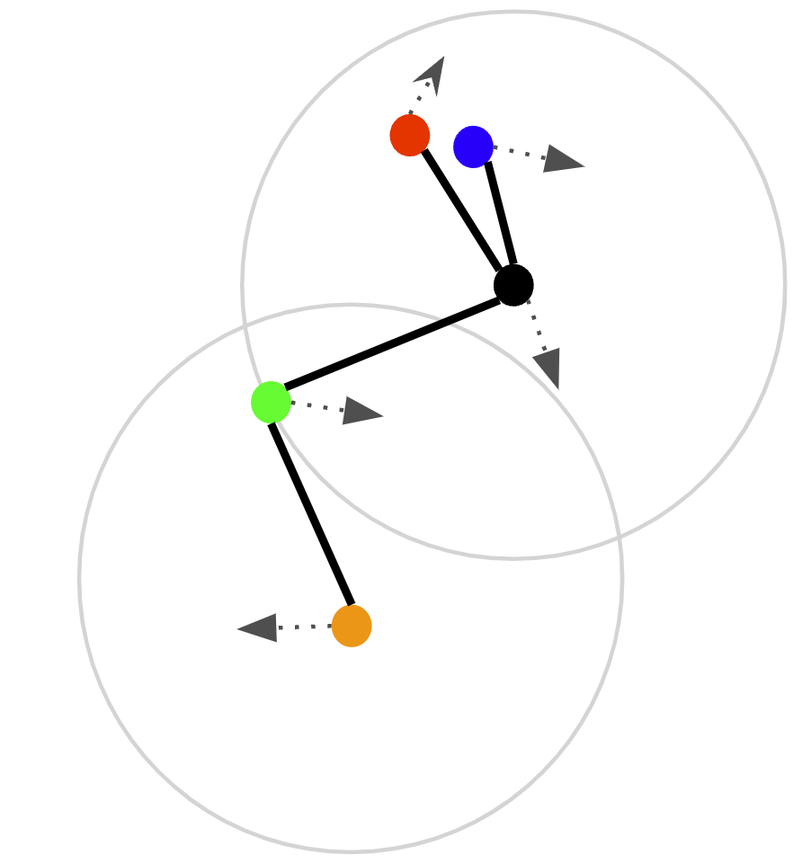
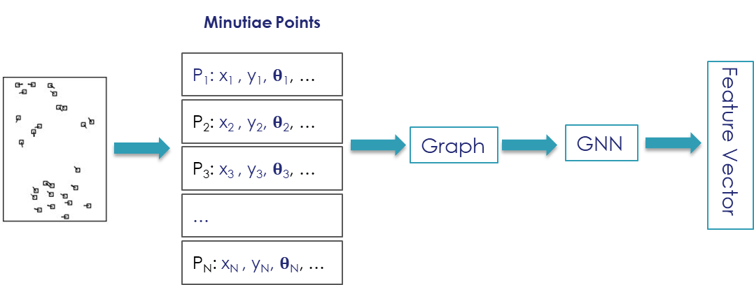
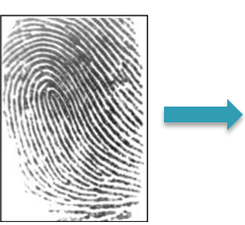
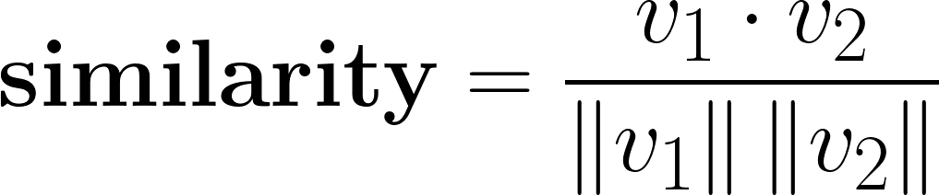
Existing Solutions & Limitations
Basic Idea - Graph Neural Networks (GNNs)
v

Slide 5
Existing Solutions & Limitations
MRA-GNN[1]
3D Graph Matching[2]
Deep Geometric Graph Convolutional Network[3]
Uses minutia (x,y,d) as input node features (NOT geometric invariant)
k nearest neighbors with unoriented edge, no extra information
3D minutia (x, y, z, dx, dy, dz) as input node features (NOT geometric invariant)
Try to make the graph invariant by adding a spatial transform network to standardize the finger pose
Extract minutiae features from the image
k nearest neighbors with the minutiae feature difference as edge feature (NOT geometric invariant)
[1] Y. Su, T. Zhao and Z. Zhang, "MRA-GNN: Minutiae Relation-Aware Model over Graph Neural Network for Fingerprint Embedding," 2023 IEEE International Joint Conference on Biometrics (IJCB), Ljubljana, Slovenia, 2023, pp. 1-10
[2] Cui, Zhe, Yuwei Jia, Siyang Zheng, and Fei Su. "Contactless Fingerprint Recognition Using 3D Graph Matching." arXiv preprint arXiv:2409.08782 (2024)
[3] Y. Shi, Z. Zhang, S. Liu and M. Liu, "Towards More Accurate Matching of Contactless Fingerprints With a Deep Geometric Graph Convolutional Network," in IEEE Transactions on Biometrics, Behavior, and Identity Science, vol. 5, no. 1, pp. 29-38, Jan. 2023

Slide 6
Existing Solutions & Limitations
CN118196843A[4]
WO2024218538A1[5]
Sweat pore matching instead of minutiae
Extract sweat pore features from the image
k nearest neighbors with the minutiae feature difference as edge feature (NOT geometric invariant)
Minutiae as nodes may contain features x, y, d , type, … (NOT geometric invariant)
Edge features may contain nodes distance, relative angle between two minutiae, ridge count …
[4] Patent: OCT fingerprint matching method based on graph neural network
[5] Patent: Fingerprint Feature Matching with Graph Neural Networks

Slide 7
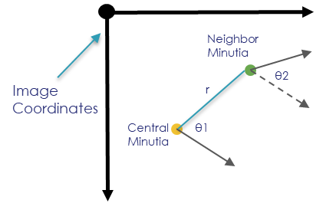
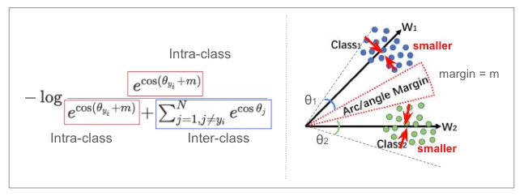
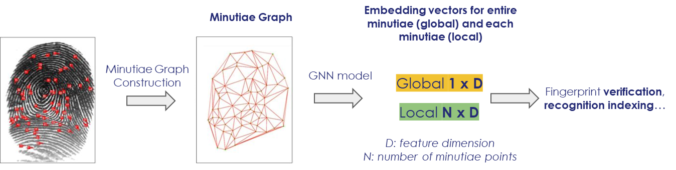
Proposed Solution
Nodes: minutiae, but contains features of quality, type, curvature, texture, … instead of x, y, d
Local coordinates: aligned with the central minutia direction
Edges: relative to the central minutia, (r, θ1, θ2) (Geometric Invariant)
Neighborhood: fixed distance; k-nearest; k-plet
Framework Overview
Arcface loss [1]
training objective
[1]Jiankang. D, et al. "ArcFace: Additive Angular Margin Loss for Deep Face Recognition." IEEE Transactions on Pattern Analysis and Machine Intelligence, vol. 44, no. 10, 2022, pp. 5962-5979.

Slide 8
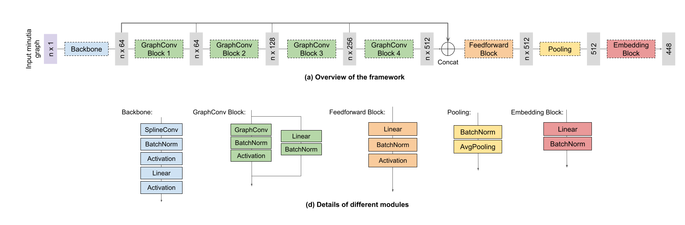
System Architecture
SplineConv and GraphConv are from PyTorch Geometric(PyG) under the MIT License, while the others are from PyTorch.

Slide 9
Preliminary Results
TAR (True Acceptance Rate) of Cogent 2K(2000 subjects, 20000 fingers 1-to-1)
Train: NIST 302, CGTO (197,777 fingers = 1.3B samples)
Test: Cogent 2K, NIST SD14
Coding speed: CPU 22.6ms from minutia sets to global embedding vector (d-448) in onnxruntime pytorch
Matching speed: CPU 772K/second in python
Converts an extracted minutia set into a global embedding vector at high speed
Serves as a fast matcher (filter)
FAR | 0.01% | 0.1% | 1% | EER
Global Embedding | 95.96% | 96.58% | 97.11% | 97.38%
Minex | 96.47% | 96.95% | 97.48% | 97.68%
Ours (d-448) | 90.10% | 92.82% | 94.99% | 96.15%
TAR of NIST SD14 (2700 subjects, 1-to-1)
FAR | 0.01% | 0.1% | 1% | EER
Global Embedding^{[1]} | 99.64% | 99.80% | 99.91% | --
matcher S2^{[1]} | 94.66% | 95.33% | 95.92% | --
Ours (d-448)^{[2]} | 97.30% | 98.67% | 99.37% | 99.34%
[1] The Global Embedding and our current matcher S2 test 2697 subjects, without 000095, 000992, 001565.
[2] last 270 subjects, 2700 fingers, as in most papers.

